Slide 1

Blazor Azure Static Web Apps
Devup 2022
6.6.22

Slide 2
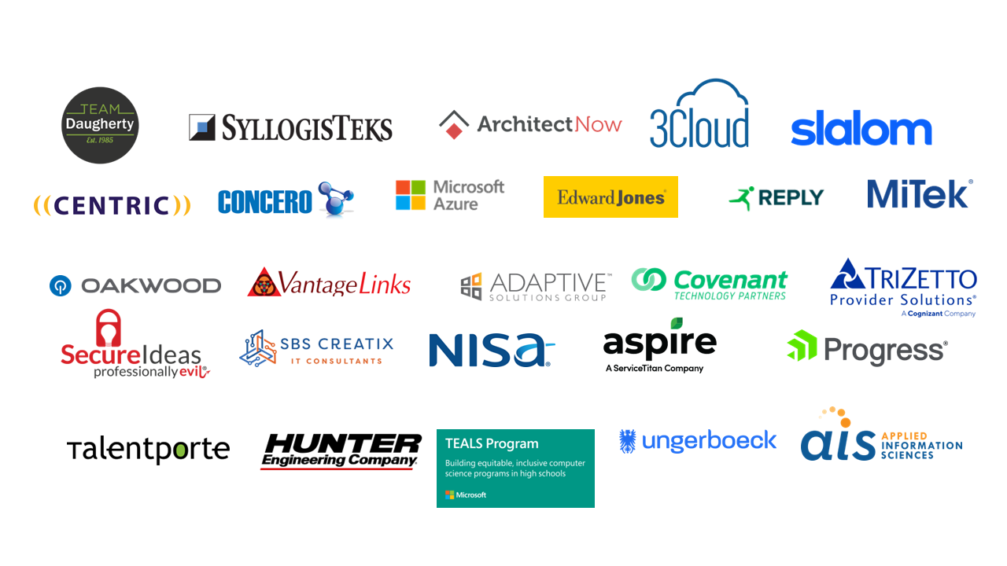

Slide 3


Slide 4


Agenda
Overview
API
Security
Storage
Monitoring
Visual Studio
Notes:
What you should get out of this session:
1 – What is Azure Static Web Apps
2 – When you would want to use it.
3 – How to integrate it with other Azure services.
4 – Best practices with examples in Blazor.
5 – Setting up your local environment for efficient development.

Slide 5






About Me
Scott Kuhl
Enterprise Developer By Day
LaunchCode Teacher By Night
@scottkuhl
@scottrkuhl
@scottkuhl

Slide 6

Overview
Azure Static Web Apps
Simple & Fast
Not just a static file web server.
Integrated API with Azure Functions.
Simple third-party sign on.
Custom Domain
Global Hosting
Free SSL
Staging Environment
DevOps
Role Auth
Notes:
Show costs.
Free or $9 / month
https://azure.microsoft.com/en-gb/pricing/details/app-service/static/#pricing
Comparison (Launch, User Ramp Up, Estimated Prod Load)
Blazor WASM = $1 / $10 / $32
ASP.NET Core = $14 / $65 / $83

Slide 7

Overview
Blazor Web Assembly
C# in the browser.
That means on the client.
That means no more very little JavaScript.
Yes, they can.
Apple Can’t Kill It!
Notes:
Server vs Web Assembly
Use Web Assembly when you want offline support or suspect very poor network conditions. You want to keep your cost to the lowest possible.
Use Server when you need protect your IP.
Server does scale well. The Hanselman story.
SEO
Google should work.
Use Prerendering. (Not supported in Static Web Apps) Switch to Azure App Service - Azure Front Door
https://github.com/jsakamoto/BlazorWasmPreRendering.Build

Slide 8

ZERO to LAUNCH
DEMO TIME
Notes:
Clone the Blazor starting repo, setup an Azure Static Web App, publish first version.
https://docs.microsoft.com/en-us/azure/static-web-apps/deploy-blazor
Create a new repo from template:
https://github.com/staticwebdev/blazor-starter/generate
Add a Static Web App on the Azure Portal:
https://portal.azure.com/
Show Action running on the Repo.
Show live running app.

Slide 9
First Update
DEMO TIME
Notes:
Do a PR.
View Stage Site.
Approve PR.
Delete Branch.
View Live Site.

Slide 10

API
Azure Functions
Lightweight Web API HTTP Only Consumption Model Integrated Security No CORS rules needed Bring Your Own – Standard Plan
Notes:
Overview of Azure Function – show static web app config "routes": [
{
"route": "/api/manage/*",
"allowedRoles": [ "administrator" ]
},
],
Consumption - $0.20 / million executions, first million free

Slide 11

Security
Easy Auth
Easy Auth
Built-In Providers
Alternate Providers
Running Locally
Notes:
Easy Auth –
Just links (login, logout, profile, purge): /.auth/login/{provider}
App role management
Claims requests from the provider
Invite system
Providers – Microsoft, GitHub, Twitter (You can choose to block any of them)
Alternates – Apple, Facebook, Google or Any OpenID Connect
Static Web App CLI provides fake authentication.
https://github.com/Azure/static-web-apps-cli/issues/390
https://github.com/Azure/azure-functions-core-tools/issues/2985
Cloud UI Role Management in Azure Portal

Slide 12
LOCAL SECURITY
DEMO TIME
Notes:
Run the application.
Run the SWA CLI.
Call the Login URL.

Slide 13

Files and Images
Azure Table Storage
Azure Table Storage
Transaction Capable
Local or Global
Notes:
Azurite is used for local development. Automatically setup with Visual Studio.
Costs 100GB 1,000,000 reads
Local 4.5 $.04
Global 6 $.04
Local: Azure Storage Explorer
Cloud: Azure Portal

Slide 14

Databases
Managed
SQL
PostgreSQL, MySQL, MariaDB
Cosmos DB
Table Storage
Notes:
Relational Costs (0.10 / GB)
SQL 370 (serverless is available)
PostgreSQL 25
MySQL 25
MariaDB 25
NoSQL Costs
Cosmos DB (0.25 / GB)
Provisioned 24 / month for 400 request units per second
Serverless 1 for 4 million request units per month
Table storage can be a NoSQL database. Limited to a single index.
Can be used for cheap caching.
Local: Cosmos Emulator
Cloud: Azure Portal

Slide 15

Monitoring
Application Insights
Application Insights
Just Turn It On
Well supported for out of the box logger, Serilog, etc.
Notes:
Availability Web Tests
Application Dashboard
Slowness and failure analysis by request.
Live stream you can watch when you deploy a new release
Cloud: Azure Portal

Slide 16


Progressive Web Apps
Visual Studio
Offline support for Static Web Apps
Ignore (/.auth/)
Ignore (/api/)

Slide 17

Local Development
Visual Studio
VS Code and Visual Studio Ready in the default repo
Visual Studio needs authentication help
HELP WANTED
Visual Studio for Mac
Rider
Notes:
Visual Studio Issues with Authentication
npm install -g @azure/static-web-apps-cli
"launchUrl": "http://localhost:4280/",
Command Task Runner (64-bit)
swa start http://localhost:5000 --devserver-timeout=6000000

Slide 18
Code Examples
DEMO TIME
Notes:
https://github.com/scottkuhl/devup2022
Static Web App Auto Start StaticWebApp.cmd
Commands.json
Client\Properties\LaunchSettings.json
Cosmos DB
Api\Common\Data\Entity.cs
Api\Common\Data\CosmosDbRepository.cs
Api\Data\Movies\MovieEntity.cs
Api\Data\Movies\MovieRepository.cs
Api\Data\Migration.cs
Api\MovieFunction.cs
Client\Pages\FetchMovies.razor
Error Handling
Shared\Common\ErrorDetails.cs
Api\Common\Function.cs
Api\Common\MovieFunction.cs
Client\Shared\MainLayout.cs
Client\Pages\FetchMovies.razor
Authorization
Api\MovieFunction.cs
Client\Pages\FetchMovies.razor
Client\Shared\NavMenu.razor
Client\staticwebapp.config
Client\_Imports.razor
Azure Storage
Api\Data\Images\ImageRepository.cs
Api\ImageFunction.cs
Api\local.settings.json
Api\Startup.cs
Client\Component\ImageUpload.razor
Reference
README.md
https://github.com/scottkuhl/BlazorStaticWebApp

Slide 19

SUMMARY
Fast First Deploy
C# in the Browser
DevOps and Staging
Authentication and Authorization
Image and File Storage
Cloud Databases
Monitoring
Workstation Setup

Slide 20


Any Questions???
https://github.com/scottkuhl/devup2022

